Slide 1
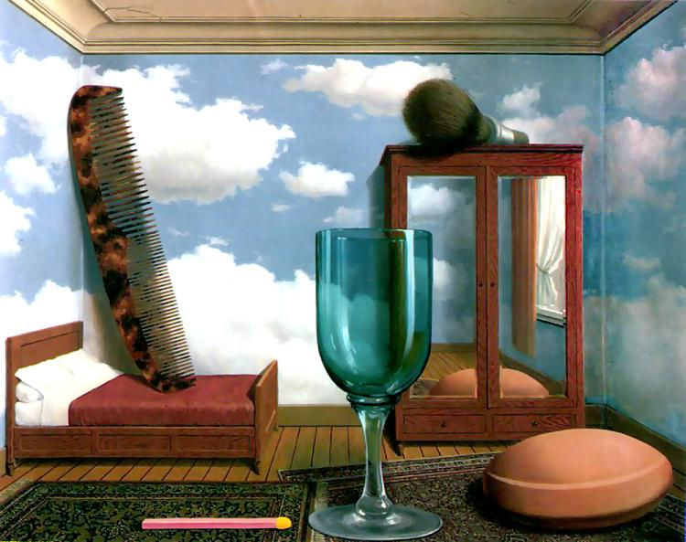
Single-view Metrology and Camera Calibration
01/25/11
Computer Vision
Derek Hoiem, University of Illinois

Slide 2
Some questions about course philosophy
Why is there no required book?
Why is the reading different from the lectures?
Why are the lectures going so fast… or so slow?
Why is there no exam?

Slide 3
Announcements
HW 1 is out
I won’t be able to make office hours tomorrow (a prelim was already scheduled)
David Forsyth will teach on Thurs

Slide 4
Last Class: Pinhole Camera
.
Optical Center (u₀, v₀)
.
.
f
Z
Y
.
v
Camera Center (t_{x}, t_{y}, t_{z})
u

Slide 5
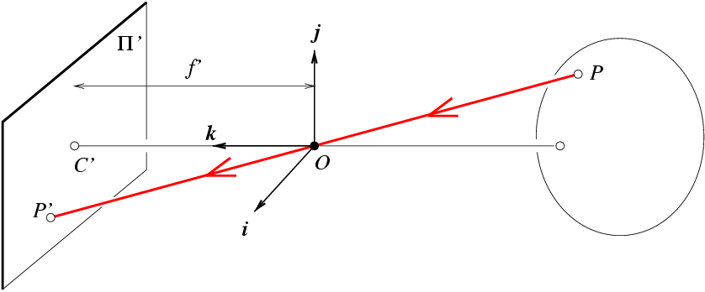
Last Class: Projection Matrix
R
j_{w}
t
k_{w}
O_{w}
i_{w}
Notes:
As review:
1) Example of my eye and their eye, where both coordinate frames are known. Suppose that I know a 3D point on the board in relation to me, and I want to figure out where that point will appear on their retina. First, I translate from my eye to their eye. Then, I rotate from my orientation to theirs. Finally, I project from 3D onto the 2D visual field.
2) Suppose I know x, K, R, and t. Can I compute X? What can I know about X?

Slide 6
Last class: Vanishing Points
Vertical vanishing
point
(at infinity)
Vanishing
line
Vanishing
point
Vanishing
point
Slide from Efros, Photo from Criminisi

Slide 7
This class
How can we calibrate the camera?
How can we measure the size of objects in the world from an image?
What about other camera properties: focal length, field of view, depth of field, aperture, f-number?

Slide 8
How to calibrate the camera?

Slide 9
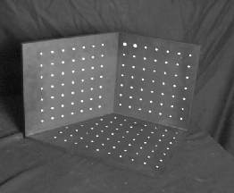
Calibrating the Camera
Method 1: Use an object (calibration grid) with known geometry
Correspond image points to 3d points
Get least squares solution (or non-linear solution)

Slide 10
Linear method
Solve using linear least squares
Ax=0 form

Slide 11
Calibration with linear method
Advantages: easy to formulate and solve
Disadvantages
Doesn’t tell you camera parameters
Doesn’t model radial distortion
Can’t impose constraints, such as known focal length
Doesn’t minimize right error function (see HZ p. 181)
Non-linear methods are preferred
Define error as difference between projected points and measured points
Minimize error using Newton’s method or other non-linear optimization

Slide 12
Calibrating the Camera
Method 2: Use vanishing points
Find vanishing points corresponding to orthogonal directions
Vertical vanishing
point
(at infinity)
Vanishing
line
Vanishing
point
Vanishing
point

Slide 13
Calibration by orthogonal vanishing points
Intrinsic camera matrix
Use orthogonality as a constraint
Model K with only f, u₀, v₀
What if you don’t have three finite vanishing points?
Two finite VP: solve f, get valid u₀, v₀ closest to image center
One finite VP: u₀, v₀ is at vanishing point; can’t solve for f
For vanishing points

Slide 14
Calibration by vanishing points
Intrinsic camera matrix
Rotation matrix
Set directions of vanishing points
e.g., X₁ = [1, 0, 0]
Each VP provides one column of R
Special properties of R
inv(R)=R^{T}
Each row and column of R has unit length

Slide 15
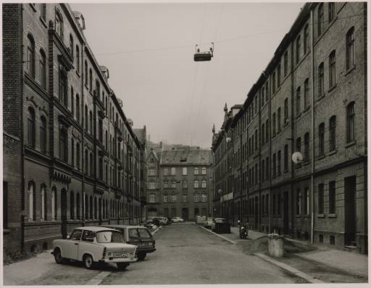
Take-home question
10/7/2010
Suppose you have estimated three vanishing points corresponding to orthogonal directions. How can you recover the rotation matrix that is aligned with the 3D axes defined by these points?
Assume that intrinsic matrix K has three parameters
Remember, in homogeneous coordinates, we can write a 3d point at infinity as (X, Y, Z, 0)
VP_{y}
.
VP_{x}
VP_{z}
Photo from online Tate collection

Slide 16
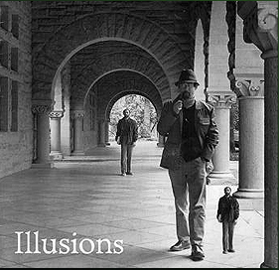
How can we measure the size of 3D objects from an image?
Slide by Steve Seitz

Slide 17
Perspective cues
Slide by Steve Seitz

Slide 18
Perspective cues
Slide by Steve Seitz

Slide 19
Perspective cues
Slide by Steve Seitz

Slide 20
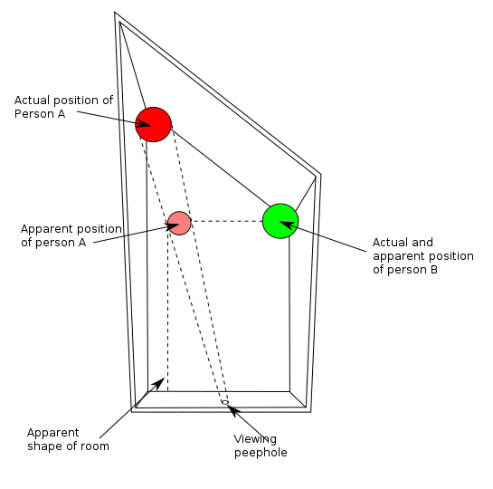
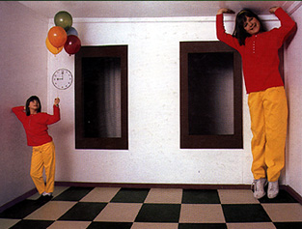
Ames Room

Slide 21
Comparing heights
Slide by Steve Seitz
Vanishing
Point

Slide 22
Measuring height
Slide by Steve Seitz
5.3
5
Camera height
4
3.3
3
2.8
2
1

Slide 23

Which is higher – the camera or the man in the parachute?

Slide 24
Computing vanishing points (from lines)
v
q₂
q₁
p₂
p₁
Intersect p₁q₁ with p₂q₂
Least squares version
Better to use more than two lines and compute the “closest” point of intersection
See notes by Bob Collins for one good way of doing this:
http://www-2.cs.cmu.edu/~ph/869/www/notes/vanishing.txt

Slide 25
Measuring height without a ruler
Slide by Steve Seitz
C
Z
ground plane
Compute Z from image measurements

Slide 26
The cross ratio
Slide by Steve Seitz
A Projective Invariant
Something that does not change under projective transformations (including perspective projection)
The cross-ratio of 4 collinear points
P₄
P₃
P₂
P₁
Can permute the point ordering
4! = 24 different orders (but only 6 distinct values)
This is the fundamental invariant of projective geometry

Slide 27
Measuring height
Slide by Steve Seitz
∞
scene cross ratio
T (top of object)
t
r
R (reference point)
C
H
b
R
image cross ratio
v_{Z}
B (bottom of object)
ground plane
scene points represented as
image points as

Slide 28

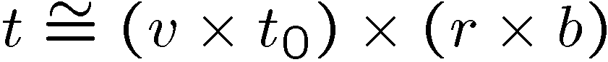
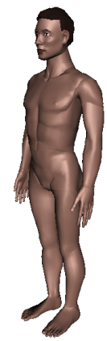
Measuring height
Slide by Steve Seitz
v_{z}
r
vanishing line (horizon)
t₀
t
v_{x}
v
v_{y}
H
R
H
b₀
b
image cross ratio

Slide 29
Measuring height
Slide by Steve Seitz
v_{z}
r
t₀
vanishing line (horizon)
t₀
v_{x}
v
v_{y}
m₀
t₁
b₀
b₁
b
What if the point on the ground plane b₀ is not known?
Here the guy is standing on the box, height of box is known
Use one side of the box to help find b₀ as shown above

Slide 30
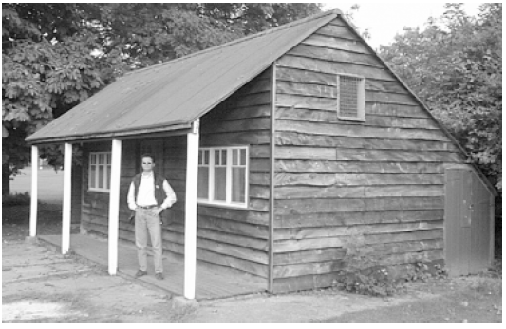
Take-home question
Assume that the camera height is 5 ft.
What is the height of the man?
What is the height of the building?
How long is the left side of the building, compared to the right side?

Slide 31
What about focus, aperture, DOF, FOV, etc?

Slide 32
Adding a lens
“circle of
confusion”
A lens focuses light onto the film
There is a specific distance at which objects are “in focus”
other points project to a “circle of confusion” in the image
Changing the shape of the lens changes this distance

Slide 33
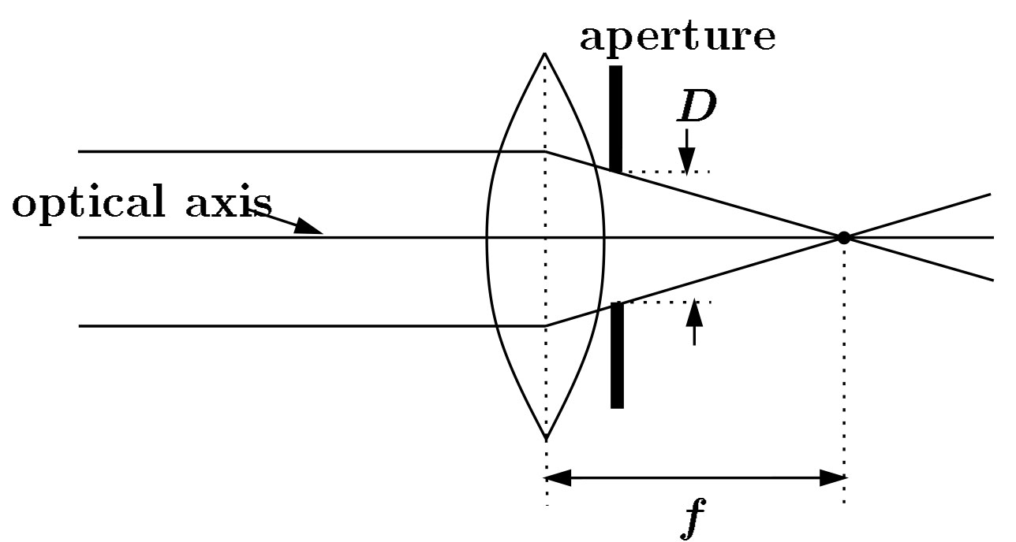
Focal length, aperture, depth of field
F
focal point
optical center
(Center Of Projection)
A lens focuses parallel rays onto a single focal point
focal point at a distance f beyond the plane of the lens
Aperture of diameter D restricts the range of rays
Slide source: Seitz

Slide 34
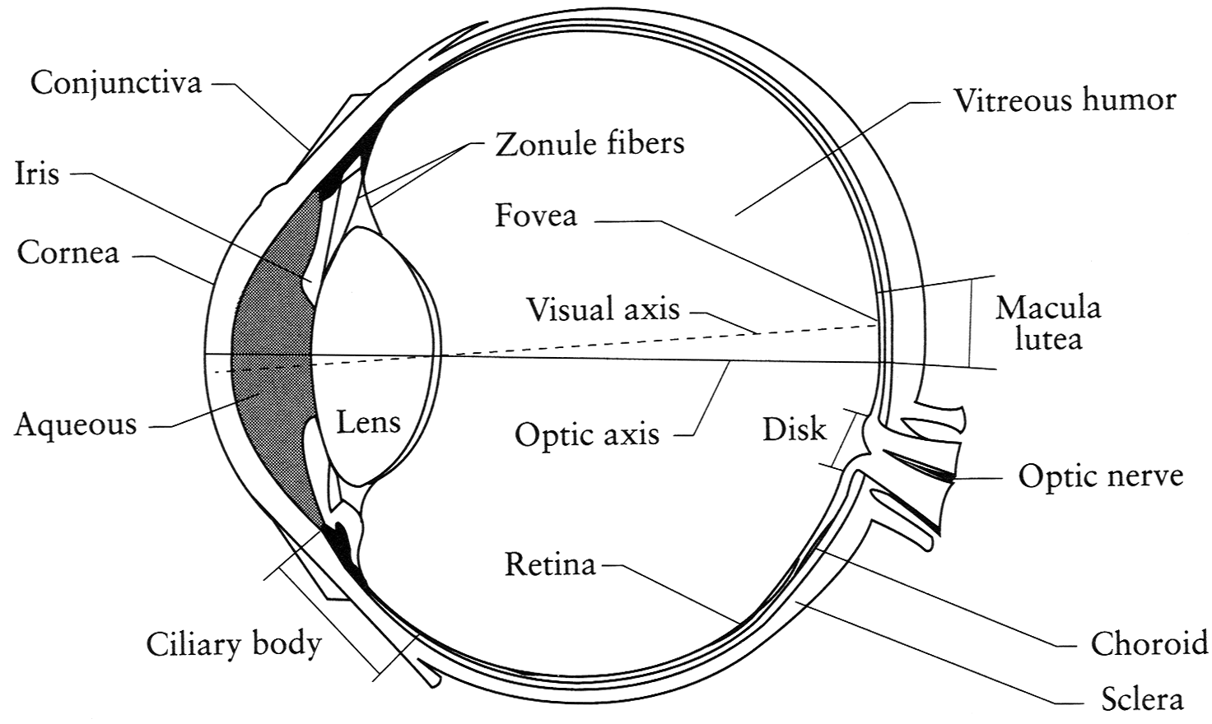
The eye
The human eye is a camera
Iris - colored annulus with radial muscles
Pupil - the hole (aperture) whose size is controlled by the iris
What’s the “film”?
photoreceptor cells (rods and cones) in the retina
Notes:
Note that the retina is curved

Slide 35

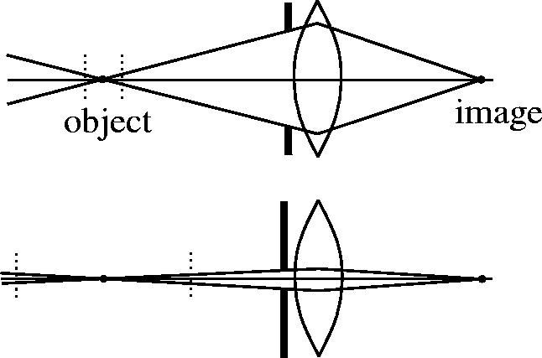

Depth of field
Slide source: Seitz
f / 5.6
f / 32
Changing the aperture size or focal length affects depth of field
Flower images from Wikipedia http://en.wikipedia.org/wiki/Depth_of_field

Slide 36
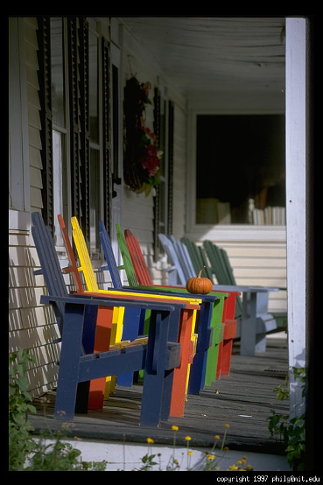
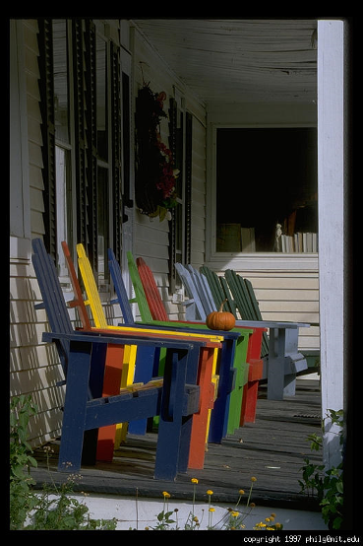
Varying the aperture
Slide from Efros
Large aperture = small DOF
Small aperture = large DOF

Slide 37
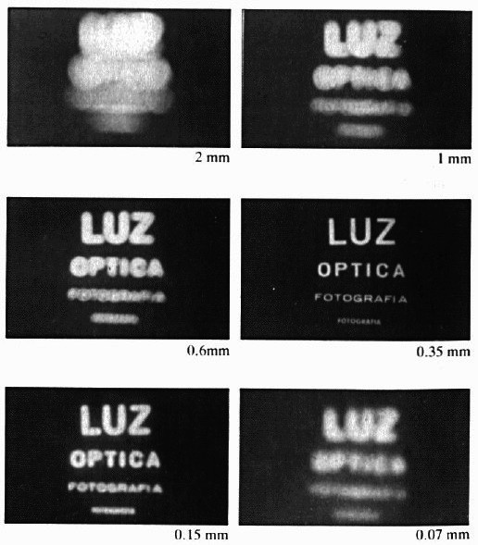
Shrinking the aperture
Why not make the aperture as small as possible?
Less light gets through
Diffraction effects
Slide by Steve Seitz

Slide 38
Shrinking the aperture
Slide by Steve Seitz

Slide 39
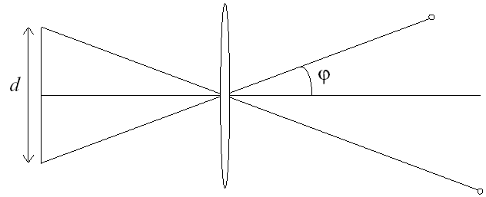
Relation between field of view and focal length
Field of view (angle width)
Film/Sensor Width
Focal length

Slide 40
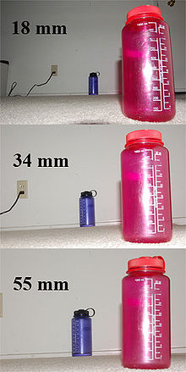
Dolly Zoom or “Vertigo Effect”
http://www.youtube.com/watch?v=Y48R6-iIYHs
How is this done?
Zoom in while moving away
http://en.wikipedia.org/wiki/Focal_length

Slide 41
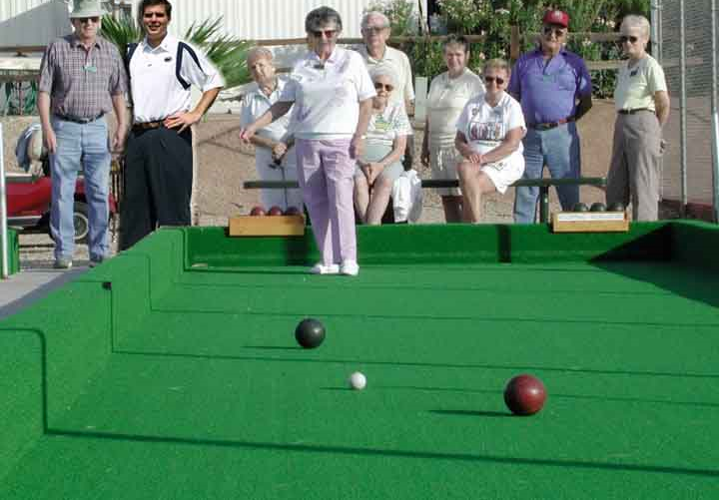
Review
How tall is this woman?
How high is the camera?
What is the camera rotation?
What is the focal length of the camera?
Which ball is closer?

Slide 42
Things to remember
Can calibrate using grid or VP
Can measure relative sizes using VP
Effects of focal length, aperture
5
4
3
2
1

Slide 43
Next class
David Forsyth talks about lighting

Slide 44
Thank you!
Questions?

